Slide 1
Checking understanding of sequences
Sequences

Slide 2
how to use Oak lessons

Slide 3
I can appreciate the structure of patterns and sequences.

Slide 4
A sequence is a succession of objects, diagrams or values usually formed according to a rule.

Slide 5

Checking understanding of sequences
Sequences with a constant additive pattern
Sequences with a constant multiplicative pattern

Slide 6
Sequences with a constant additive pattern
A sequence is a succession of objects, diagrams or values usually formed according to a rule.
Below is a sequence of numbers. What do you notice about this sequence?
3, 6, 9, 12, …
If you add 3 on to the previous number, you get the next number.
You may have noticed that this is the beginning of the 3 times table.

Slide 7

Sequences with a constant additive pattern
Here is a section of the 2 times table on a number line.
+2
+2
+2
+2
32
34
36
38
40
42
−2
−2
−2
−2
How could you calculate the missing value after 40?
How could you calculate the missing value before 34?

Slide 8
Sequences with a constant additive pattern
Jacob is writing his 4 times table and has got to the values below:
… 224, 228, 230, 234…
How do you know he has made a mistake?
The numbers in the 4 times table increase by 4 each time. The difference between 228 and 230 is not 4.
Multiplication tables are an example of a sequence with a constant additive relationship.
Successive numbers in the 2 times table have a difference of 2
Successive numbers in the 3 times table have a difference of 3
Successive numbers in the 4 times table have a difference of 4

Slide 9
Sequences with a constant additive pattern
Each sequence is a section of a multiplication table.
Match the sequence with the multiplication table it is part of.
… 392, 399, 406, 413, …
…230, 235, 240, 245, …
… 264, 275, 286, 297, …
… 189, 198, 207, 216, …
5 times table
7 times table
9 times table
11 times table

Slide 10
Sequences with a constant additive pattern
Below is a 100 square. Lucas has shaded all the numbers in the 10 times table which are on the 100 square.
1 | 2 | 3 | 4
If he writes these in ascending order, they form a sequence with a difference of 10 between each value.
10, 20, 30, 40 …
This sequence follows a constant additive rule, where to get the next number you always add 10.

Slide 11


Sequences with a constant additive pattern
Jun has shaded a different set of numbers.
1 | 2 | 3 | 4
I have shaded the 9 times table.
Jun
Is Jun correct?
No, the first number he has shaded is 9 but the second number is 19 which is not in the 9 times table.

Slide 12
Sequences with a constant additive pattern
Jun has shaded a different set of numbers.
1 | 2 | 3 | 4
Do the numbers Jun has shaded form a sequence with a constant additive rule?
Yes, he has shaded:
9, 19, 29, 39, 49, …
This sequence of numbers is formed by adding 10 each time.
Successive numbers in the sequence have a difference of 10.

Slide 13
Sequences with a constant additive pattern
How could we calculate the difference between successive values in these sequences formed by constant additive rules?
+2
+2
29, 31, 33, …
258, 584, 910, …
7.8, 9.2, 10.6, …
31 − 29 = 2
7
1
+326
+326
− 5 8 4
− 2 5 8
584 − 258
3
2
6
+1.4
+1.4
9.2 − 7.8 = 1.4

Slide 14
Sequences with a constant additive pattern
Forming a sequence by adding a negative value will create a decreasing sequence.
+ (−4)
−4
−4
…
27
23
19
…
15
+4
Adding −4 is the same as subtracting 4
We can subtract 4 from 19 to get the next number.
We can add 4 to 23 to get the previous number.

Slide 15

Sequences with a constant additive pattern
The values 27, 41, 57, … form a sequence that follows a constant additive rule.
The same value hasn’t been added to 27 and to 41
41 - 27 = 14 but 57 - 41 = 16
27, 41 and 57 are not in the same times table.
It is not just the multiplication tables which form additive sequences

Slide 16
Sequences with a constant additive pattern
These sequences continue in equal steps.
What is the previous number in each sequence?
+3
…, , 29, 32, …
…, , 12.7, 13.3, …
…, , 4.8, 2.9, …
29 − 3= 26
12.7 − 0.6 = 12.1
4.8 − −1.9 = 6.7 or 4.8 + 1.9 = 6.7
+0.6
+ −1.9

Slide 17


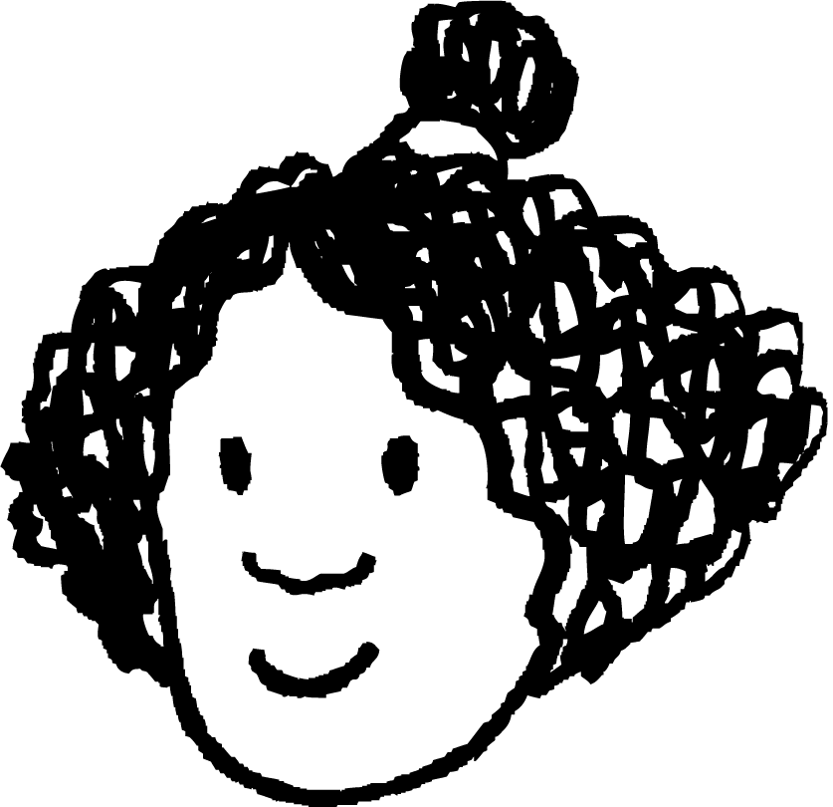






Sequences with a constant additive pattern
These pupils are making number patterns from a rule.
Aisha says any number, Andeep adds a number to it. Each pupil then adds the same number Andeep added. For each question, justify your answer.
If Aisha says 6 and Andeep says 10, what will Izzy say?
If Aisha says 6 and Andeep says 10, what will Sofia say?
After a different starting number Sam says 17 and Alex says 19. What did Aisha say?
If Aisha says 4 to start and Jun says 40, what will Lucas say?
Aisha starts with 10 and only Lucas’ number is another integer. What could Andeep have said?
Aisha
Andeep
Izzy
Jacob
Jun
Lucas
Laura
Sam
Alex
Sofia

Slide 18
Sequences with a constant additive pattern
These pupils are making number patterns from a rule.
Aisha says any number, Andeep adds a number to it. Each pupil then adds the same number Andeep added. For each question, justify your answer.
If Aisha says 6 and Andeep says 10, what will Izzy say?
Izzy will say 14 as Andeep added 4 to Aisha’s number and 10 + 4 = 14
If Aisha says 6 and Andeep says 10, what will Sofia say?
Sofia will say 42 as 4 will have been added another 8 times after Andeep says 10
Aisha
Andeep
Izzy
Jacob
Jun
Lucas
Laura
Sam
Alex
Sofia

Slide 19
Sequences with a constant additive pattern
These pupils are making number patterns from a rule.
Aisha says any number, Andeep adds a number to it. Each pupil then adds the same number Andeep added. For each question, justify your answer.
After a different starting number Sam says 17 and Alex says 19. What did Aisha say?
Aisha said 3. Each pupil is adding 2. Subtracting 2 seven times from 17 is 3.
If Aisha says 4 to start and Jun says 40, what will Lucas say?
Lucas says 49. A number has to be added 4 times to get from Aisha to Jun. The difference between their numbers is 36 so each pupil adds 9.
Aisha
Andeep
Izzy
Jacob
Jun
Lucas
Laura
Sam
Alex
Sofia

Slide 20
Sequences with a constant additive pattern
These pupils are making number patterns from a rule.
Aisha says any number, Andeep adds a number to it. Each pupil then adds the same number Andeep added. For each question, justify your answer.
Aisha starts with 10 and only Lucas’ number is another integer. What could Andeep have said?
Andeep could have added any non-integer value which is a multiple of 0.2
e.g 10 + 0.4 = 10.4 or 10 + 5.6 = 15.6 or 10 + 3.2 = 13.2
There are 5 additions between Aisha and Lucas if Lucas said 11 then
1 ÷ 5 = 0.2
If Lucas said 12 then 2 ÷ 5 = 0.4
Aisha
Andeep
Izzy
Jacob
Jun
Lucas
Laura
Sam
Alex
Sofia

Slide 21
Checking understanding of sequences
Sequences with a constant additive pattern
Sequences with a constant multiplicative pattern

Slide 22
Sequences with a constant multiplicative pattern
Jacob has written the values: 2, 4, 8
If Jacob was writing a sequence, he has missed out the number 6.
These could be the first 3 numbers in a sequence.
Jun
Lucas
Do you agree with either statement?
Lucas is thinking of the sequence 2, 4, 6, 8 which is formed by using a constant additive rule of plus 2 each time.

Slide 23
Sequences with a constant multiplicative pattern
Jacob has written the values: 2, 4, 8
If Jacob was writing a sequence, he has missed out the number 6.
These could be the first 3 numbers in a sequence.
Lucas
Jun
Jun is thinking of a different rule that could make this sequence.
Sequences don’t have to follow a rule but there are patterns other than additive ones that we can find and use.

Slide 24
Sequences with a constant multiplicative pattern
Some sequences follow a multiplicative rule.
We could continue Jacob’s sequence by following a constant multiplicative pattern.
×2
×2
×2
2
4
8
16
…

Slide 25
Sequences with a constant multiplicative pattern
We can calculate the next value in a sequence with a constant multiplicative pattern by first calculating the multiplier.
×5
×5
×5
2
10
50
250
…
The calculation 10 ÷ 2 or 50 ÷ 10 tells us the multiplier is 5
Calculating 50 × 5 will find the next number in the sequence.
5 × 10
× 5
5 × 5 × 10
25 × 10 = 250

Slide 26
Sequences with a constant multiplicative pattern
This sequence has a constant multiplicative pattern. What is the multiplier?
…, 8, 104, …
8
13
26
96

Slide 27



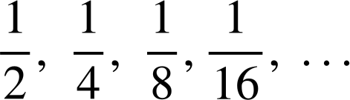


Sequences with a constant multiplicative pattern
We have seen how the sequence 2, 4, 8, 16, … has a constant multiplicative pattern.
How could we describe this sequence?
The value is halving each time.
This can be written as ÷ 2 or

Slide 28

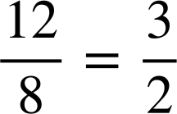
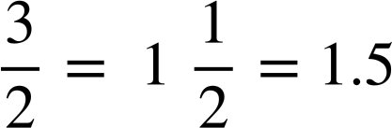
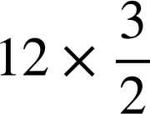
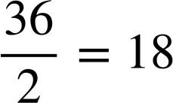
Sequences with a constant multiplicative pattern
Sequences can have decimal or fractional multipliers.
…
8
12
…
Calculating 12 ÷ 8 will find the multiplier.
Calculating will find the next number in the sequence.

Slide 29


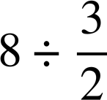
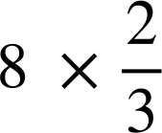
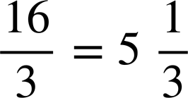
Sequences with a constant multiplicative pattern
…
8
12
18
…
Calculating will find the previous number in the sequence.

Slide 30
Sequences with a constant multiplicative pattern
This sequence has a constant multiplicative pattern. What is the multiplier?
…, 42, 21, …
2
−2
−21

Slide 31



Sequences with a constant multiplicative pattern
This sequence has a constant multiplicative pattern. What is the multiplier?
…, 5, 3, …
−2

Slide 32
Sequences with a constant multiplicative pattern
Jun has written the numbers:
1, −1, 1, −1, …
+(−2)
+2
+(−2)
1
−1
1
−1
…
This is a sequence with a constant additive pattern as 1 and −1 have a difference of 2
The amount being added each time is different so this is not a sequence with a constant additive pattern.
Do you agree with Jun?
Jun
Can you see another relationship between successive numbers in this pattern?

Slide 33
Sequences with a constant multiplicative pattern
Jacob has written the numbers:
1, −1, 1, −1, …
×−1
×−1
×−1
1
−1
1
−1
…
This is a sequence with an additive pattern as 1 and −1 have a difference of 2
Each value has been multiplied by −1 to get the next value.
The sequence alternates between positive and negative values.
Jun

Slide 34
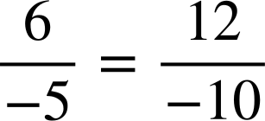
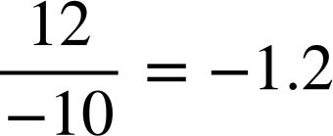
Sequences with a constant multiplicative pattern
Sequences can have negative multipliers.
× (−5)
× (−5)
−1.2
…
6
−30
150
…
÷ (−5)
Calculating (−30) × (−5) will find the next number in the sequence.
Calculating 6 ÷ (−5) will find the previous number in the sequence.

Slide 35
Sequences with a constant multiplicative pattern
A sequence with a constant multiplicative pattern can decrease.
Multiplying by any decimal will give a number less than the previous one.
Multiplying by a value between 0 and 1 will give a number less than the previous one.

Slide 36
Sequences with a constant multiplicative pattern
A sequence with a constant multiplicative pattern can contain both positive and negative numbers.
Multiplying a positive number by a negative multiplier gives a negative number.
If you multiply by a fractional multiplier enough times eventually you will get a negative number.

Slide 37
Sequences with a constant multiplicative pattern
Sort these sequences into the correct column.
Sequences with a constant additive relationship | Sequences with a constant multiplicative relationship
5, 10, 15, 20, …
5.7, 8.1, 10.5, 12.9, …
3, -6, 12, -24 …
1, 2, 4, 8, …
48, 24, 12, 6, …
6, 48, 90, 132, …
3, 30, 300, 3000, …
1.5, 0.5, -0.5, -1.5, …
0.5, 1.5, 4.5, 13.5, …

Slide 38

Sequences with a constant multiplicative pattern
2) Find the missing numbers in these sequences with constant multiplicative patterns.
6, 12, 24, , …
5, 30, , 1080, …
160, 80, 40, , …
0.3, -3, 30, , …
e) , 21, 63, 189, …
f) 1, 0.2, 0.04, , …
g) ,8, 160, ,64 000, …
h) , 6, 8, , …

Slide 39
Sequences with a constant multiplicative pattern
Sort these sequences into the correct column.
Sequences with a constant additive relationship | Sequences with a constant multiplicative relationship
5, 10, 15, 20, …
1, 2, 4, 8, …
3, 30, 300, 3000, …
5.7, 8.1, 10.5, 12.9, …
48, 24, 12, 6, …
1.5, 0.5, -0.5, -1.5, …
3, -6, 12, -24 …
6, 48, 90, 132, …
0.5, 1.5, 4.5, 13.5 …

Slide 40
Sequences with a constant multiplicative pattern
2) Find the missing numbers in these sequences with constant multiplicative patterns.
6, 12, 24, 48, …
5, 30, 180, 1080, …
160, 80, 40, 20, …
0.3, -3, 30, -300, …
e) 7, 21, 63, 189, …
f) 1, 0.2, 0.04,0.008, …
g) 0.4, 8, 160, 3200,64 000, …
h) 4.5, 6, 8, , …

Slide 41
Checking understanding of sequences
Sequences can be formed with an additive pattern.
Sequences with a multiplicative relationship have a specific multiplier which can be found.

Slide 42

© Oak National Academy 2023.
Produced in partnership with Mathematics in Education and Industry.
Licensed on the Open Government Licence v3.0, except where otherwise stated. See Oak terms and conditions.

